Slide 1
Initial Report
Daily Universe - Winter 2012 Survey for Comms 318 Last Modified: 03/19/2012

Slide 2
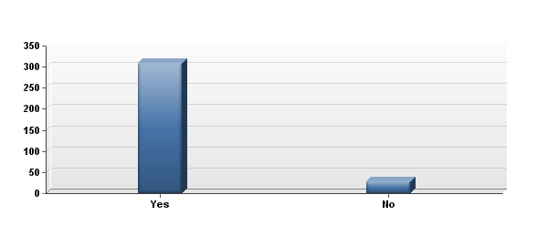
1. Are you a full-time BYU student?

Slide 3
1. Are you a full-time BYU student?

Slide 4
1. Are you a full-time BYU student?
# | Answer | Response | %
1 | Yes | 308 | 92%
2 | No | 28 | 8%
 | Total | 336 | 100%

Slide 5
1. Are you a full-time BYU student?
Statistic | Value
Min Value | 1
Max Value | 2
Mean | 1.08
Variance | 0.08
Standard Deviation | 0.28
Total Responses | 336

Slide 6
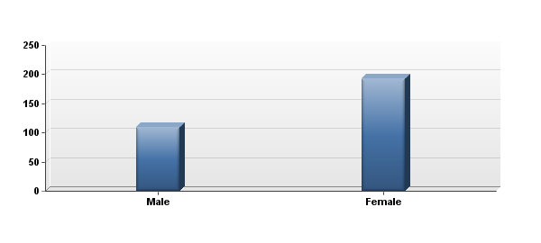
2. Please indicate your gender.

Slide 7
2. Please indicate your gender.
# | Answer | Response | %
1 | Male | 110 | 36%
2 | Female | 193 | 64%
 | Total | 303 | 100%

Slide 8
2. Please indicate your gender.
Statistic | Value
Min Value | 1
Max Value | 2
Mean | 1.64
Variance | 0.23
Standard Deviation | 0.48
Total Responses | 303

Slide 9
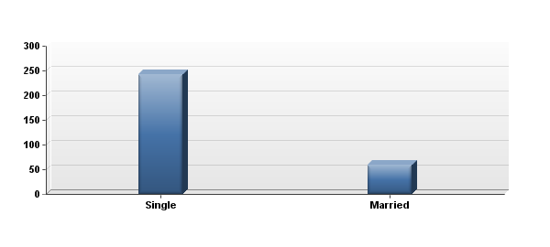
3. What is your marital status?

Slide 10
3. What is your marital status?
# | Answer | Response | %
1 | Single | 243 | 80%
2 | Married | 60 | 20%
 | Total | 303 | 100%

Slide 11
3. What is your marital status?
Statistic | Value
Min Value | 1
Max Value | 2
Mean | 1.20
Variance | 0.16
Standard Deviation | 0.40
Total Responses | 303

Slide 12
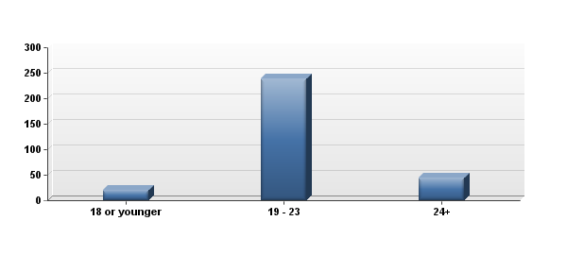
4. Which age group do you fall into?

Slide 13
4. Which age group do you fall into?
# | Answer | Response | %
1 | 18 or younger | 21 | 7%
2 | 19 - 23 | 238 | 79%
3 | 24+ | 44 | 15%
 | Total | 303 | 100%

Slide 14
4. Which age group do you fall into?
Statistic | Value
Min Value | 1
Max Value | 3
Mean | 2.08
Variance | 0.21
Standard Deviation | 0.46
Total Responses | 303

Slide 15
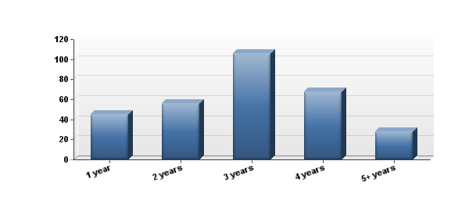
5. How many years have you been a student at BYU?

Slide 16
5. How many years have you been a student at BYU?
# | Answer | Response | %
1 | 1 year | 45 | 15%
2 | 2 years | 56 | 18%
3 | 3 years | 106 | 35%
4 | 4 years | 68 | 22%
5 | 5+ years | 28 | 9%
 | Total | 303 | 100%

Slide 17
5. How many years have you been a student at BYU?
Statistic | Value
Min Value | 1
Max Value | 5
Mean | 2.93
Variance | 1.37
Standard Deviation | 1.17
Total Responses | 303

Slide 18
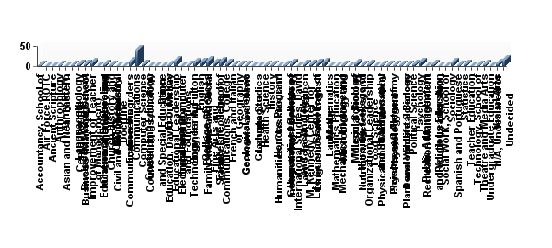
6. What course of study or college are you in?

Slide 19
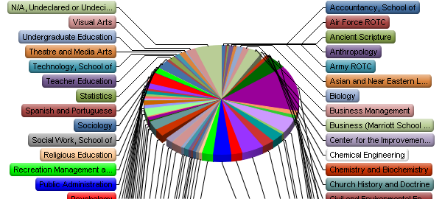
6. What course of study or college are you in?

Slide 20
6. What course of study or college are you in?
# | Answer | Response | %
1 | Accountancy, School of | 3 | 1%
2 | Air Force ROTC | 1 | 0%
3 | Ancient Scripture | 1 | 0%
4 | Anthropology | 3 | 1%
5 | Army ROTC | 0 | 0%
6 | Asian and Near Eastern Languages | 2 | 1%
7 | Biology | 4 | 1%
8 | Business Management | 4 | 1%
9 | Business (Marriott School of Management) | 8 | 3%
10 | Center for the Improvement of Teacher Education and Schooling (CITES) | 0 | 0%
11 | Chemical Engineering | 4 | 1%
12 | Chemistry and Biochemistry | 2 | 1%
13 | Church History and Doctrine | 0 | 0%
14 | Civil and Environmental Engineering | 1 | 0%
15 | Communication Disorders | 12 | 4%
16 | Communications | 41 | 13%
17 | Computer Science | 4 | 1%
18 | Continuing Education | 0 | 0%
19 | Counseling Psychology and Special Education | 0 | 0%
20 | Dance | 0 | 0%
21 | Economics | 3 | 1%
22 | Education, David O. McKay School of | 14 | 5%
23 | Educational Leadership and Foundations | 0 | 0%
24 | Electrical and Computer Engineering | 2 | 1%
25 | Engineering and Technology, Ira A. Fulton College of | 8 | 3%
26 | English | 8 | 3%
27 | Exercise Sciences | 14 | 5%
28 | Family, Home and Social Sciences, College of | 7 | 2%
29 | Family Life, School of | 11 | 4%
30 | Fine Arts and Communications, College of | 7 | 2%
31 | French and Italian | 2 | 1%
32 | Geography | 2 | 1%
33 | Geological Sciences | 2 | 1%
34 | Germanic and Slavic Languages | 1 | 0%
35 | Graduate Studies | 0 | 0%
36 | Health Science | 2 | 1%
37 | History | 3 | 1%
38 | Honors Program | 0 | 0%
39 | Humanities, Classics, and Comparative Literature | 2 | 1%
40 | Humanities, College of | 7 | 2%
41 | Instructional Psychology and Technology | 0 | 0%
42 | International Studies, David M. Kennedy Center for | 5 | 2%
43 | Law School, J. Reuben Clark | 4 | 1%
44 | Life Sciences, College of | 6 | 2%
45 | Linguistics and English Language | 8 | 3%
46 | Mathematics | 0 | 0%
47 | Mathematics Education | 1 | 0%
48 | Mechanical Engineering | 3 | 1%
49 | Microbiology and Molecular Biology | 1 | 0%
50 | Music, School of | 7 | 2%
51 | Nursing, College of | 3 | 1%
52 | Nutrition, Dietetics, and Food Science | 4 | 1%
53 | Organizational Leadership and Strategy | 0 | 0%
54 | Philosophy | 2 | 1%
55 | Physical and Mathematical Sciences, College of | 2 | 1%
56 | Physics and Astronomy | 2 | 1%
57 | Physiology and Developmental Biology | 3 | 1%
58 | Plant and Wildlife Sciences | 2 | 1%
59 | Political Science | 5 | 2%
60 | Psychology | 10 | 3%
61 | Public Administration | 0 | 0%
62 | Recreation Management and Youth Leadership | 5 | 2%
63 | Religious Education | 0 | 0%
64 | Social Work, School of | 0 | 0%
65 | Sociology | 8 | 3%
66 | Spanish and Portuguese | 2 | 1%
67 | Statistics | 4 | 1%
68 | Teacher Education | 1 | 0%
69 | Technology, School of | 3 | 1%
70 | Theatre and Media Arts | 4 | 1%
71 | Undergraduate Education | 1 | 0%
72 | Visual Arts | 6 | 2%
73 | N/A, Undeclared or Undecided | 17 | 6%
 | Total | 304 | 100%

Slide 21
6. What course of study or college are you in?
Statistic | Value
Min Value | 1
Max Value | 73
Mean | 35.67
Variance | 440.45
Standard Deviation | 20.99
Total Responses | 304

Slide 22
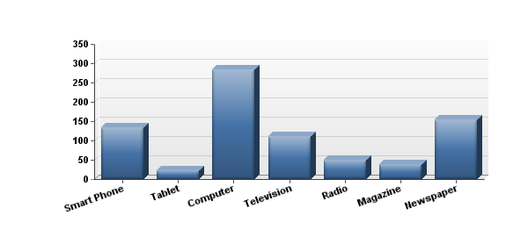
7. What medium do you use to get your news? (check all that apply)

Slide 23
7. What medium do you use to get your news? (check all that apply)
# | Answer | Response | %
1 | Smart Phone | 134 | 44%
2 | Tablet | 22 | 7%
3 | Computer | 283 | 94%
4 | Television | 111 | 37%
5 | Radio | 50 | 17%
6 | Magazine | 38 | 13%
7 | Newspaper | 155 | 51%

Slide 24
7. What medium do you use to get your news? (check all that apply)
Statistic | Value
Min Value | 1
Max Value | 7
Total Responses | 302

Slide 25
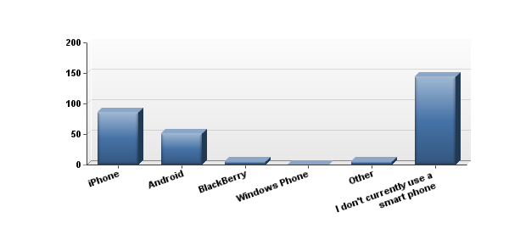
8. If you use a smart phone to obtain your news, which device do you use? (select only one)

Slide 26
8. If you use a smart phone to obtain your news, which device do you use? (select only one)
# | Answer | Response | %
1 | iPhone | 86 | 29%
2 | Android | 52 | 18%
3 | BlackBerry | 5 | 2%
4 | Windows Phone | 0 | 0%
5 | Other | 5 | 2%
6 | I don't currently use a smart phone | 144 | 49%
 | Total | 292 | 100%

Slide 27
8. If you use a smart phone to obtain your news, which device do you use? (select only one)
Statistic | Value
Min Value | 1
Max Value | 6
Mean | 3.75
Variance | 5.32
Standard Deviation | 2.31
Total Responses | 292

Slide 28
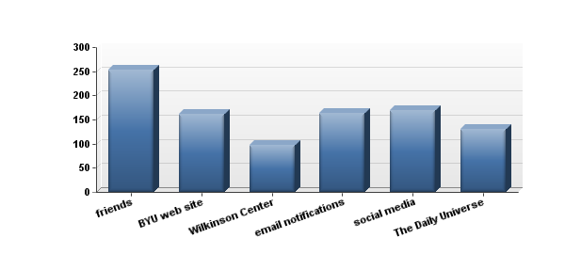
9. How do you keep informed of events on BYU campus? (check all that apply)

Slide 29
9. How do you keep informed of events on BYU campus? (check all that apply)
# | Answer | Response | %
1 | friends | 253 | 84%
2 | BYU web site | 161 | 54%
3 | Wilkinson Center | 98 | 33%
4 | email notifications | 164 | 55%
5 | social media | 169 | 56%
6 | The Daily Universe | 131 | 44%

Slide 30
9. How do you keep informed of events on BYU campus? (check all that apply)
Statistic | Value
Min Value | 1
Max Value | 6
Total Responses | 300

Slide 31
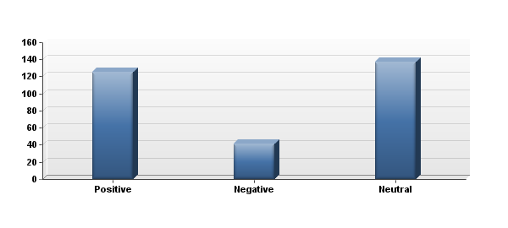
10. When considering The Daily Universe, how would you describe your feelings about this news source?

Slide 32
10. When considering The Daily Universe, how would you describe your feelings about this news source?
# | Answer | Response | %
1 | Positive | 125 | 41%
2 | Negative | 41 | 14%
3 | Neutral | 137 | 45%
 | Total | 303 | 100%

Slide 33
10. When considering The Daily Universe, how would you describe your feelings about this news source?
Statistic | Value
Min Value | 1
Max Value | 3
Mean | 2.04
Variance | 0.87
Standard Deviation | 0.93
Total Responses | 303

Slide 34
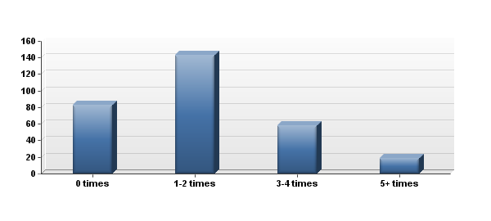
11. On average, how often do you read The Daily Universe in a week?

Slide 35
11. On average, how often do you read The Daily Universe in a week?
# | Answer | Response | %
1 | 0 times | 83 | 27%
2 | 1-2 times | 143 | 47%
3 | 3-4 times | 58 | 19%
4 | 5+ times | 19 | 6%
 | Total | 303 | 100%

Slide 36
11. On average, how often do you read The Daily Universe in a week?
Statistic | Value
Min Value | 1
Max Value | 4
Mean | 2.04
Variance | 0.72
Standard Deviation | 0.85
Total Responses | 303

Slide 37
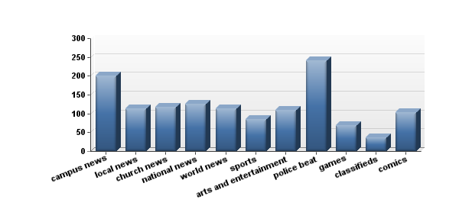
12. What parts of The Daily Universe interest you most? (check all that apply)

Slide 38
12. What parts of The Daily Universe interest you most? (check all that apply)
# | Answer | Response | %
1 | campus news | 200 | 68%
2 | local news | 114 | 39%
3 | church news | 117 | 40%
4 | national news | 126 | 43%
5 | world news | 113 | 39%
6 | sports | 85 | 29%
7 | arts and entertainment | 109 | 37%
8 | police beat | 241 | 83%
9 | games | 68 | 23%
10 | classifieds | 36 | 12%
11 | comics | 104 | 36%

Slide 39
12. What parts of The Daily Universe interest you most? (check all that apply)
Statistic | Value
Min Value | 1
Max Value | 11
Total Responses | 292

Slide 40
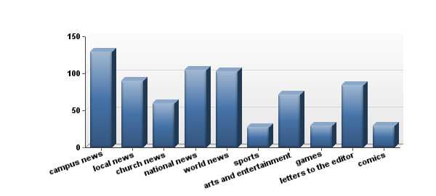
13. What would you like to see more of in The Daily Universe? (check all that apply)

Slide 41
13. What would you like to see more of in The Daily Universe? (check all that apply)
# | Answer | Response | %
1 | campus news | 129 | 46%
2 | local news | 90 | 32%
3 | church news | 60 | 21%
4 | national news | 105 | 37%
5 | world news | 103 | 36%
6 | sports | 27 | 10%
7 | arts and entertainment | 72 | 25%
8 | games | 29 | 10%
9 | letters to the editor | 84 | 30%
10 | comics | 29 | 10%

Slide 42
13. What would you like to see more of in The Daily Universe? (check all that apply)
Statistic | Value
Min Value | 1
Max Value | 10
Total Responses | 283

Slide 43
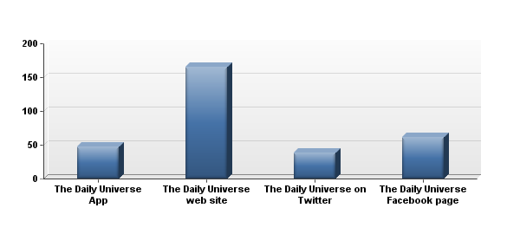
14. What sources/versions of The Daily Universe have you accessed before? (check all that apply)

Slide 44
14. What sources/versions of The Daily Universe have you accessed before? (check all that apply)
# | Answer | Response | %
1 | The Daily Universe App | 48 | 24%
2 | The Daily Universe web site | 166 | 83%
3 | The Daily Universe on Twitter | 38 | 19%
4 | The Daily Universe Facebook page | 61 | 30%

Slide 45
14. What sources/versions of The Daily Universe have you accessed before? (check all that apply)
Statistic | Value
Min Value | 1
Max Value | 4
Total Responses | 201

Slide 46
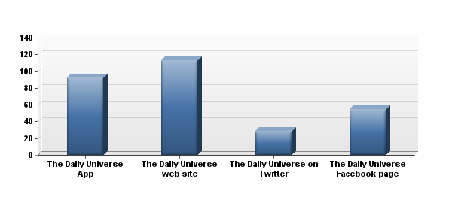
15. Which of these options would you be most interested in using? (select only one)

Slide 47
15. Which of these options would you be most interested in using? (select only one)
# | Answer | Response | %
1 | The Daily Universe App | 92 | 32%
2 | The Daily Universe web site | 113 | 39%
3 | The Daily Universe on Twitter | 29 | 10%
4 | The Daily Universe Facebook page | 55 | 19%
 | Total | 289 | 100%

Slide 48
15. Which of these options would you be most interested in using? (select only one)
Statistic | Value
Min Value | 1
Max Value | 4
Mean | 2.16
Variance | 1.16
Standard Deviation | 1.08
Total Responses | 289

Slide 49
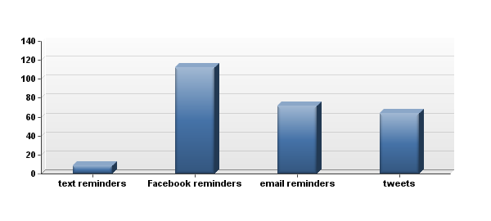
16. What would motivate you to visit The Daily Universe web site? (check all that apply)

Slide 50
16. What would motivate you to visit The Daily Universe web site? (check all that apply)
# | Answer | Response | %
1 | text reminders | 9 | 4%
2 | Facebook reminders | 112 | 44%
3 | email reminders | 72 | 28%
4 | tweets | 64 | 25%
 | Total | 257 | 100%

Slide 51
16. What would motivate you to visit The Daily Universe web site? (check all that apply)
Statistic | Value
Min Value | 1
Max Value | 4
Mean | 2.74
Variance | 0.76
Standard Deviation | 0.87
Total Responses | 257

Slide 52
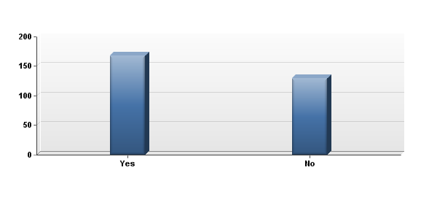
17. Do you feel that The Daily Universe accurately represents the perspective of BYU students?

Slide 53
17. Do you feel that The Daily Universe accurately represents the perspective of BYU students?
# | Answer | Response | %
1 | Yes | 168 | 56%
2 | No | 130 | 44%
 | Total | 298 | 100%

Slide 54
17. Do you feel that The Daily Universe accurately represents the perspective of BYU students?
Statistic | Value
Min Value | 1
Max Value | 2
Mean | 1.44
Variance | 0.25
Standard Deviation | 0.50
Total Responses | 298

Slide 55
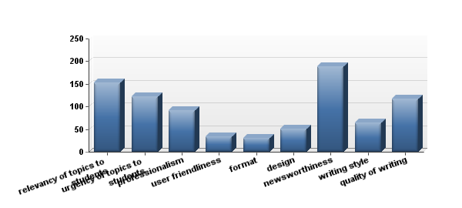
18. What do you think The Daily Universe could improve on? (check all that apply)

Slide 56
18. What do you think The Daily Universe could improve on? (check all that apply)
# | Answer | Response | %
1 | relevancy of topics to students | 153 | 53%
2 | urgency of topics to students | 123 | 43%
3 | professionalism | 91 | 32%
4 | user friendliness | 34 | 12%
5 | format | 30 | 10%
6 | design | 51 | 18%
7 | newsworthiness | 189 | 66%
8 | writing style | 64 | 22%
9 | quality of writing | 118 | 41%

Slide 57
18. What do you think The Daily Universe could improve on? (check all that apply)
Statistic | Value
Min Value | 1
Max Value | 9
Total Responses | 288

Slide 58
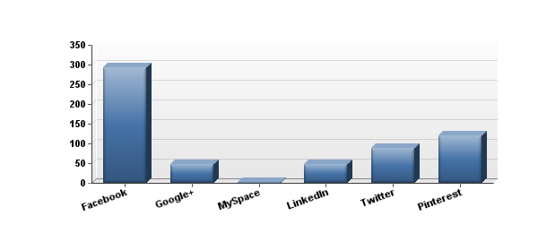
19. What social media sources do you regularly use? (check all that apply)

Slide 59
19. What social media sources do you regularly use? (check all that apply)
# | Answer | Response | %
1 | Facebook | 294 | 98%
2 | Google+ | 48 | 16%
3 | MySpace | 2 | 1%
4 | LinkedIn | 47 | 16%
5 | Twitter | 88 | 29%
6 | Pinterest | 121 | 40%

Slide 60
19. What social media sources do you regularly use? (check all that apply)
Statistic | Value
Min Value | 1
Max Value | 6
Total Responses | 300

Slide 61
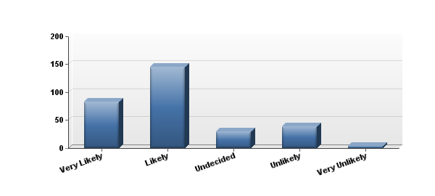
20. How likely are you to share a news story that interests you with friends? (select one)

Slide 62
20. How likely are you to share a news story that interests you with friends? (select one)
# | Answer | Response | %
1 | Very Likely | 83 | 27%
2 | Likely | 146 | 48%
3 | Undecided | 30 | 10%
4 | Unlikely | 39 | 13%
5 | Very Unlikely | 4 | 1%
 | Total | 302 | 100%

Slide 63
20. How likely are you to share a news story that interests you with friends? (select one)
Statistic | Value
Min Value | 1
Max Value | 5
Mean | 2.12
Variance | 1.00
Standard Deviation | 1.00
Total Responses | 302

Slide 64
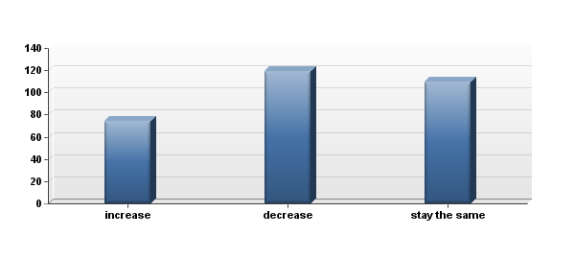
21. Starting in April, The Daily Universe will move to a digital-first format. The majority of informati...

Slide 65
21. Starting in April, The Daily Universe will move to a digital-first format. The majority of informati...
# | Answer | Response | %
1 | increase | 74 | 24%
2 | decrease | 119 | 39%
3 | stay the same | 110 | 36%
 | Total | 303 | 100%

Slide 66
21. Starting in April, The Daily Universe will move to a digital-first format. The majority of informati...
Statistic | Value
Min Value | 1
Max Value | 3
Mean | 2.12
Variance | 0.60
Standard Deviation | 0.77
Total Responses | 303

Slide 67
22. Please provide us with your email address so we can include you in the random drawing for the BYU Bo...
Text Response
bstowell@adobe.com
jessicadelphi@gmail.com
malloryc4@gmail.com
laurakjohnson100@gmail.com
mckinlee@byu.net
alisavage91@gmail.com
zoe.corinne@gmail.com
kaitlinmariephotography@gmail.com
jeremy.w.passey@gmail.com
nhslax54@gmail.com
speedyswimmer1000@gmail.com
Ymerizoip@yahoo.com
jessierudd2009@hotmail.com
kerissa.poulson@gmail.com
meganjeffries@gmail.com
hatfield.malory@gmail.com
adam.durfee@ymail.com
kaiti.purse@gmail.com
Michelle.a.may@gmail.com
chuchendorf@gmail.com
purple_lindsay@hotmail.com
brookelebaron@msn.com
lesliegerber0@gmail.com
anneew1@gmail.com
annieeichers@hotmail.com
eagle_pride14@yahoo.com
caileyg4@gmail.com
bopers@cox.net
kat_orgill@hotmail.com
miriam.burton@gmail.com
laurelashby@gmail.com
superkitty88@gmail.com
jasonh@byu.edu
jasontylerallen@gmail.com
dancethis66@gmail.com
rileycooney@gmail.com
kathryn6@gmail.com
kelseyewebb@gmail.com
kyns17@gmail.com
allliecmccoy@gmail.com
jvcurtis.09@gmail.com
garrett.n.mccoy@gmail.com
samantha.b.noble@gmail.com
jeffreyjfinley@gmail.com
miavgabriel@gmail.com
tessalbeard@gmail.com
thebridget1.0@gmail.com
justin.benson0502@gmail.com
chelsaat@gmail.com
julieann.selden@gmail.com
jfoote11@gmail.com
stevikay@comcast.net
clcastagno@gmail.com
jjarman89@gmail.com
ballroomgirl@me.com
kelseylboyce@gmail.com
jennifertays@yahoo.com
brycekunz3@gmail.com
taikethemagnet@hotmail.com
thesquijim@hotmail.com
musiclover07@msn.com
andeedawn.mortensen@gmail.com
aaronjules@gmail.com
zengzeng17@gmail.com
lovell.erik13@gmail.com
Kelseyedmunds@byu.net
photosbydanyell@gmail.com
kellierachelle@gmail.com
MelodyAnnNelson@gmail.com
shannishine@gmail.com
briannampeters@gmail.com
lyssylynn5@yahoo.com
jordynwhiting90@gmail.com
jordan.l.rogers@gmail.com
myty37@gmail.com
ashley.barnes16@yahoo.com
enw@sweetwaterhsa.com
scott.lemmons@gmail.com
marciwright@gmail.com
jlcougar12@aol.com
lewis.byu@gmail.com
ssmcquay@gmail.com
croutons4mike@gmail.com
tyler.grant.walker@gmail.com
notlate@gmail.com
davidmchris@gmail.com
thomaseric197@gmail.com
vibrant.lime@gmail.com
cooleokid12@gmail.com
sdarrington11@gmail.com
kelbelnel@gmail.com
mnader_42@msn.com
asum2182@gmail.com
jessica.hernandez8@gmail.com
embelshe@gmail.com
b_rachel_6@yahoo.com
michaelryanbabcock@gmail.com
alieisrad@hotmail.com
shelbyjayne.symonds@gmail.com
mlmedaris@gmail.com
brianna.n.campbell@gmail.com

Slide 68
22. Please provide us with your email address so we can include you in the random drawing for the BYU Bo...
Statistic | Value
Total Responses | 210

