Slide 1
The Resurgence of Dunkin’ Donuts
By:
Whitney Wilcox

Slide 2
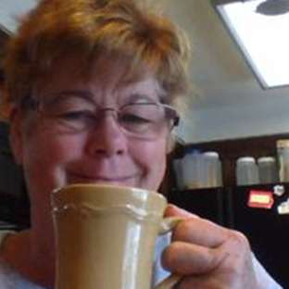
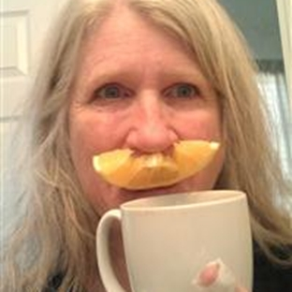
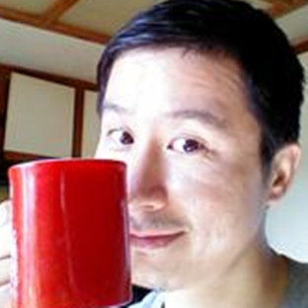
Agenda
History
PR campaign and resurgence
Conclusion—Dunkin’ Donuts today

Slide 3
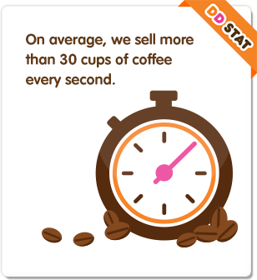
Past and Present
Began in 1950
10,500 stores in 31 countries
RF Binder since 2005
Notes:
Dunkin’ Donuts began in 1950, entering the regular and iced coffee, donut, bagel and muffin markets.
Today the company sells over 1.7 billion cups of coffee globally per year.
Company’s pledge to excellence—taste testers sample around 200 cups of coffee each day.
Around the 1990s is when the company started branching out internationally. Currently there are 10,500 stores in 31 countries.
In Spain, the company began in 1995. In 2007 the name was changed to Dunkin’ Coffee for easier recognition among patrons and to explain the product.
According to The NPD Group / CREST®, Dunkin’ Donuts serves the most hot traditional and iced coffee in America.
Dunkin’ Donuts has earned the No. 1 ranking for customer loyalty in the coffee category by Brand Keys for seven years running.
In 2012, Dunkin’ Donuts’ restaurants had global franchisee-reported sales of approximately $6.9 billion.
Dunkin’ Donuts partnered with RF Binder in 2005, but began their large-scale social media campaign around 2011.

Slide 4
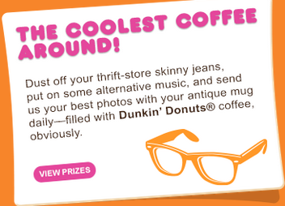
Add some social media . . .
Social media campaign “stars” fans
Twitter and #mydunkin
Adapting to fit current trends
https://www.youtube.com/watch?v=1YB8V9iV0qI
Notes:
Dunkin’ Donuts started using social media in 2008, but around 2011 was when RF Binder helped Dunkin’ Donuts create an aggressive PR campaign that would market DD as a brand that fits the lifestyle of today’s busy consumers.
Josh Gitelson, executive managing director at RF Binder, helped structure the campaign on the basis that one must:
Fuel existing fan base.
Create daily collaboration between company and client.
Construct social media programs fans can own.
Wanted something with a fun personality, creating an emotional connection with fan base, and distinguish the brand from competitors.
The social media campaign utilized multiple media platforms, including television, radio, out-of-home, mobile, social, online, as well as in-store to engage guests in as many ways as possible. DD used Twitter, Instagram, Pinterest, Vine, Blogs, Facebook, YouTube, an App for the iphone and android, and Google+.
Kevin Vine, marketing manager at DD, says, “We don’t own our social media channels, our fans do.”
The idea was to create recognition through the fans and air ads featuring real fans, using social media, created from social content.
John Costello, Dunkin’ Brands’ President of Global Marketing and Innovation, called the campaign, “A push to put guests in spotlight . . . .[It] is organic and unprecedented.”
In 2013 Dunkin’ Donuts went through thousands of posts to Facebook and Twitter to select the first fans to appear in six new television commercials that were based on original social content.
The campaign reached out to celebrities, athletes, charitable organizations, and attempted to make DD leadership accessible.
Here is some of what was tried:
Twitter followers develop nicknames for "Coolatta" flavors. The best names earned $50 Dunkin' Donuts cards.
A "Big N' Toasty Trivia Tuesdays" contest earned Dunkin' Donuts national trending topic status on Twitter twice.
To celebrate new holiday menu items, fans tweeted photos of themselves in their holiday sweaters for the chance to win a Dunkin' Donuts gift card.
National Apple Pie Day on Twitter, offering fans a prize for correctly guessing the type of apples used in the brand's warm apple pie.
“The Royal Wedding Donut”
Bloggers’ "back to school gift basket" to promote Dunkin' coffee as perfect for parents who need to keep running.
As a result:
"America Runs on Dunkin'" garners tops placements in prestigious pubs, increases social media numbers on Facebook, Twitter.From October 2010 to September 2011, Dunkin' Donuts received feature coverage in top national outlets, such as NBC's "Today Show," ABC's "Good Morning America," CBS News, "Fox & Friends," USA Today, The Associated Press, Time, CNN, The New York Times, Reuters, The Wall Street Journal, The Huffington Post, AOL and Yahoo.com.
Number of Twitter followers by nearly 80%.
11 M likes on Facebook.
Billions of media impressions.
One of leading brands in industry (compare to Starbucks, etc.).
What is DD doing today?
77% of Americans get coffee fix at home. “Do It Yourself” coffee and instructions in grocery stores.
DD smart (a better for you menu that reaches out to media personnel and mommy bloggers).
Reaching out to the Hispanic/Latino community.
The lunch market.
Handling customer complaints has brought positive recognition to the company.

Slide 5
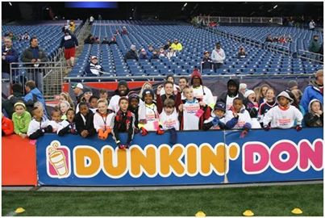
Conclusion
https://www.youtube.com/watch?v=omnpPjkkV5A&feature=em-share_video_user
Twitter followers by nearly 80%
11 M likes on Facebook
One of leading brands in industry
Notes:
Sources:
www.hermanoff.net
www.prdaily.com
www.rfbinder.com
www.ragan.com
www.bulldogreporter.net
www.socialtimes.com
www.dunkindonuts.com

